Slide 1
WEEK 3 - Tablet Team
Cameron, Sam, Lio, Ray, Diogo and Jose

Slide 2
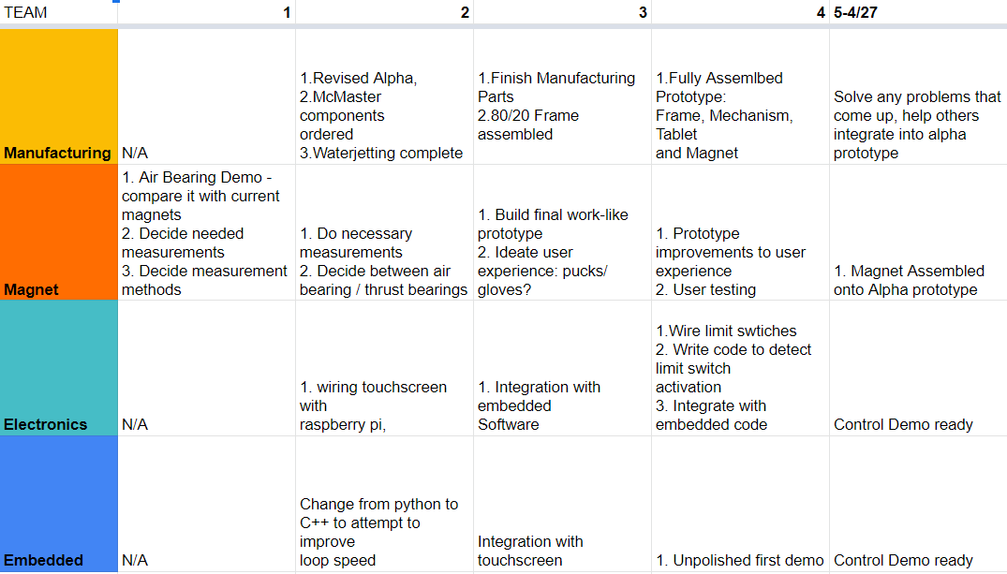
Alpha Timeline

Slide 3
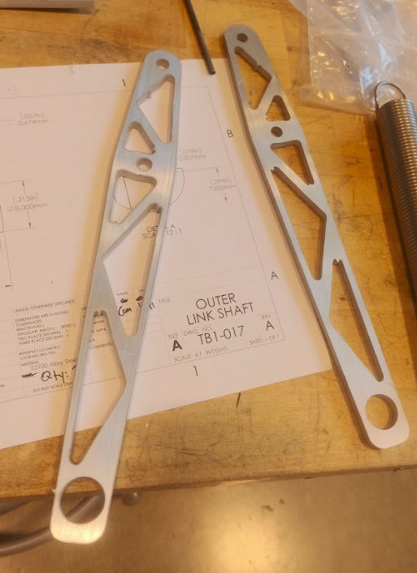
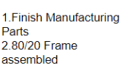
Manufacturing - Cam & Sam
Progress
Finalized Design
Started Manufacturing
All water jetting done
6/18 components fully done
Problems
Need to bore 3mm key->Billie?
Preview
Finish Manufacturing

Slide 4
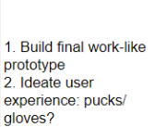
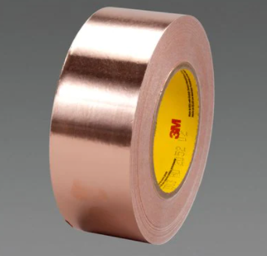
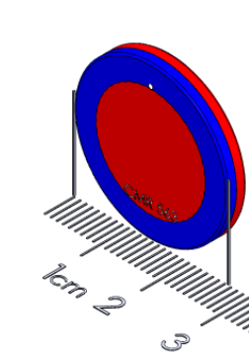
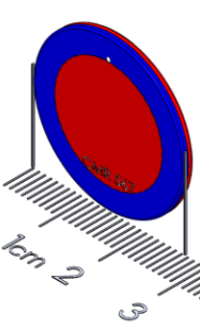
Magnet - Diogo & Jose
Magnet can now be used to touch the screen
Copper Tape
Testing different thrust bearings, all of which feel bad
Best so far - McMaster Thrust bearings
Narrowed down to ~3 magnet combinations

Slide 5

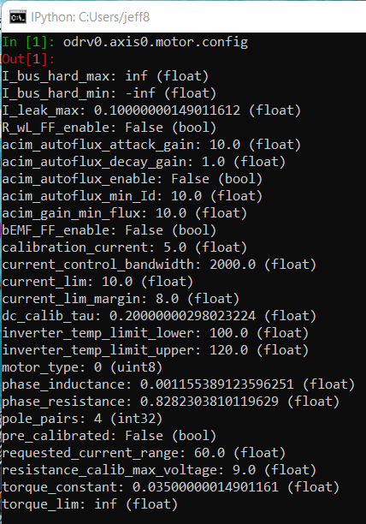
Electronics - Ray
- Progress:
- Motor: Change to BLY172D-2000 with ratio 5:1 gearbox and able to calibration. Try closed loop control and have nice stiff wall.
- Touchscreen: Wire the FFC and breakout board to touchsensor. Read with USB on Raspberry Pi and wire on breakout board.
- Problem: There is no source USB reading data just GPIO

Slide 6
Embedded - Lio Frequency test
Baud rate 2304000
One cycle contains:
Request position and vel(unit in revolution) for shoulder and elbow joint
Receive data and preprocess(offset elimination and reduction ratio calculation) to get actual angle.
Calculate position in 2D tablet and Jacobian
Determine the force act on end-effect and trans to torque with Jacobian
Send cmd to Odrive
Test result
Request: “f 0/n” 20 μs
Wait for response 100 - 200 μs
Calculation TBD
Send cmd to Odrive 50 μs
1000hz need Calculation in 700 μs
2000hz need Calculation in 200 μs
All is in single motor but we need to do 4 motors in one time

Slide 7
Embedded - Lio Frequency test
We need to do 4 motors in one time
Solution:
Take advantage of 2 odrive we have:
Odrive_1 connect 2 shoulder joint
Odrive_2 connect 2 elbow joint
Sync request left arm(or right arm)shoulder & elbow joint pos
Send back cmd to Odrive_1 & Odrive_2 at same time
Alternately control the left and right arms
Total frec 1000HZ
Microcontroller
Arm1 Shoulder Arm1 Elbow Calculation & Cmd Arm 1
Arm2 Shoulder Arm2 Elbow Calculation & Cmd Arm 2
Odrive_1
Odrive_2

Slide 8
Embedded - Lio Calibration
We need four switch add in our mech design to help us do the calibration every time we startup. Because we use the incremental encoder.
Touch screen calibration TBD.

